Slide 1
Analytics FOR BUSINESS Intelligence
Fall 2021
Nuria Diaz-Tena
Notes:
Attendance and Seating

Slide 2
Introduction & Explanatory Data Analysis
To Do from Previous Class:
Request Tableau
Install R Studio
Read Chapter 1

Slide 3
Level of Education in US of people 25 years and over in 2020
More than 90% of Americans 25 years and over graduated form High School and more than a Third of Americans graduated from College in 2020
Level of education | Number of persons (thousands) | Percent
Total | 223,058 | 100%
Less than High School | 20,208 | 9%
High school graduate | 61,597 | 28%
Some college, no degree | 33,986 | 15%
Associate's degree | 23,566 | 11%
Bachelor's degree | 52,164 | 23%
Advanced degree | 31,537 | 14%

Slide 4
Exploring The Education Level Data Set in Excel
Summarize the education of 25+ in US
Let’s change the educational levels
Source use Table 2 Both Sexes:
https://www.census.gov/data/tables/2020/demo/educational-attainment/cps-detailed-tables.html
Summarize data by a small number of educational levels
Compute Percentages for 2020
Plot Pie Chart for 2020
Bar graph for 2020
Make Table for 2020
Exploring The Population Growth in US from 2010 to 2020 in Excel

Slide 5
Exploring a CDC COVID data set
Has the percentage of Deaths by COVID change thru time?
Source: https://covid.cdc.gov/covid-data-tracker/#datatracker-home
What does each row mean?
What do the columns mean?
Is there any data problem?
Missing data
Strange values
Outliers
Line Plot

Slide 6
Assignment-1 in Pairs Introduction to R

Slide 7
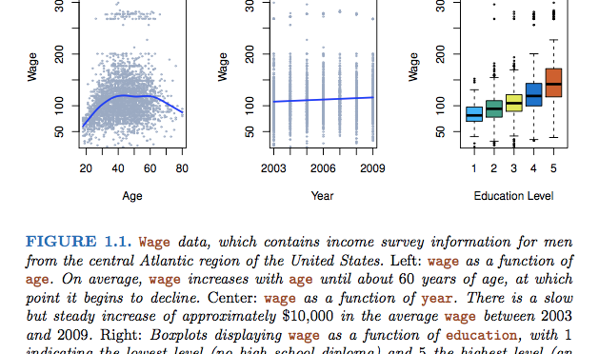
What do these plots mean?
Notes:
Name Description
Auto Gas mileage, horsepower, and other information for cars.
Bikeshare usage of a bike sharing program in Washington, DC.
Boston Housing values and other information about Boston census tracts.
BrainCancer Survival times for patients diagnosed
Caravan individuals offered caravan insurance. Information about car seat sales in 400 stores.
Carseats Information about car seat sales in 400 stores.

Slide 8
Course Planning
Lecture | Date | Topic | Assignments | Wg
1 | 9/01/21 | Introduction, Visualizations & Exploratory Data Analysis - Chapter 1
2 | 9/15/21 | Introduction to R - Chapter 2
3 | 9/22/21 | Statistical Experiments | Homework #1 | 5%
4 | 9/29/21 | Regression – Chapter 3 | Homework #2 | 5%
5 | 10/06/21 | Bayesian Models
6 | 10/13/21 | Models Review | Project #1 | 15%
 | 10/20/21 | Midterm Exam | Midterm | 20%
7 | 10/27/21 | Classification Models – Chapter 4
8 | 11/03/21 | Cross Validation and Advance Classification – Chapter 5 to 9 | Homework #3 | 5%
9 | 11/10/21 | Advance Classification | Homework #4 | 5%
10 | 11/17/21 | Support Vector Machines - Chapter 9
 |  | Thanksgiving Recess
 | 11/29/21 | Review of Machine Learning Models
11 | 12/01/21 | Clustering - Chapter 10
12 | 12/06/21 | Project Discussion
13 | 12/08/21 | Final Exam Preparation | Project #2 | 15%
 | 12/22/21 | Final Exam | Final | 30%

Slide 9
How did the US Populating change between 2010 and 2020?
The Census showed the population growth overall and by race in the United States between 2010 and 2020.
Does these charts help on achieving the following conclusions? (write YES or NO) | Pie Charts | Stack Bars | Side by side bars
The overall population has increased between 2010 and 2020
The population of "only whites" has decreased between 2010 and 2020
The proportion of "only whites" has decreased from 2010 to 2020
The ”Black or African American” has remained the 2nd most populous race
The” 2 or more races” shifted from the 5th to the 3rd most populous race
The Asians shifted from the 4th to the 5th most populous race (even though they increase their population by 5 Million)

Slide 10
Visualize THE DATA
WITH TABLEAU
EXCEL
R
TYPES OF VISUALS | EXCEL | TABLEAU | R
PIE CHARTS | PIE |  | PIE
BAR CHARTS | COLUMNS |  | BARPLOT
SIDE BY SIDE BARS | COLUMNS |  | BARPLOT
STACK BARS | COLUMNS |  | BARPLOT
LINE PLOT | LINE |  | LINES
HISTOGRAAM | STATISTICAL |  | HIST
BOX PLOT | STATISTICAL |  | BOXPLOT
SCATTERPLOT | XY (SCATTER) |  | PLOT

Slide 11
Visualize USING SCATTER PLOTS

Slide 12
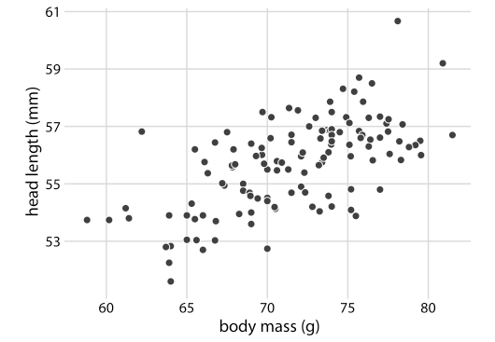
Scatter Plots
123 Blue Jay Data
Head length in mm)
Body Mass (in grams)
Each dot corresponds to one bird. There is a moderate tendency for heavier birds to have longer heads. Data source: Keith Tarvin, Oberlin College

Slide 13
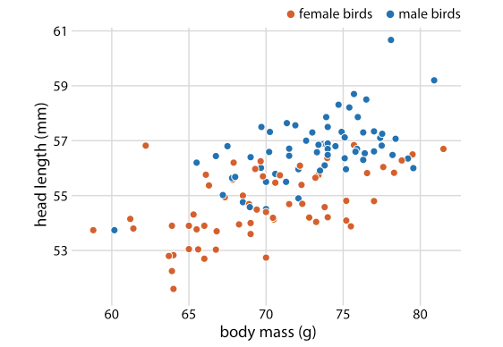
Do Female Blue Jays have longer heads than males blue jays?

Slide 14
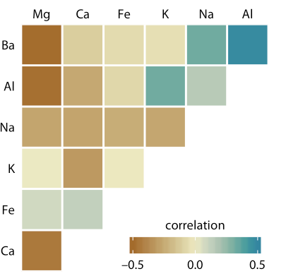
Correlogram
Correlations for mineral content for 214 samples of glass fragments. The dataset contains seven variables measuring the amounts of magnesium (Mg), calcium (Ca), iron (Fe), potassium (K), sodium (Na), aluminum (Al), and barium (Ba) found in each glass fragment. Data source: B. German
This correlogram allows us to quickly grasp trends in the data, such as that magnesium is negatively correlated with nearly all other oxides, and that aluminum and barium have a strong positive correlation.

Slide 15
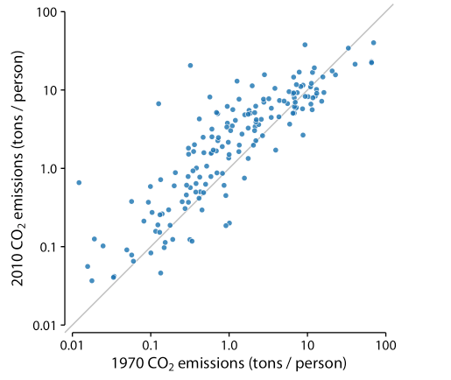
Pair Data
Carbon dioxide (CO2) emissions per person in 1970 and 2010, for 166 countries. Each dot represents one country. The diagonal line represents identical CO2 emissions in 1970 and 2010. Data source: Carbon Dioxide Information Analysis Center
The points are systematically shifted upwards relative to the diagonal line: In the majority of countries, emissions were higher in 2010 than in 1970.

Slide 16
CHECK THE DATA

Slide 17
Summarizing Numerical data – Histograms and Box Plots (One variable – Univariate Plots)
Location
Median
Mean
Variability
Range
IQR
Standard deviation
Shape
Binomial
Normal
Long Tail

Slide 18
COMPARING DATA SETS

Slide 19
What is the question? Is the delta variant affecting all the states the same?
Additional questions:
The states with lower vaccination rates are most affected by the delta variant
The states with no mask mandates are more affected by the delta variant
The elderly are more affected by the delta variant
The Hispanics and blacks are more affected by the delta variant
The obese are more affected by the delta variant
Men are more affected by the delta variant
Is the data available?
Can we collect the data using a survey?
Who is the target population?
Is the collected sample representative of the target population?
Do you need weights to analyze your sample?
Which sample size do you need?
Which data is needed?

Slide 20
What is the question
Is the mu variant worse than the delta variant?
Why some Americans refuse to wear masks?
Do cars with 4 cylinders are more efficient than cars with 6 cylinders?
Which vaccine provides the best protection against dying from COVID?
What is the profile in 2020 of the people dying from COVID?
Has the profile changed in 2021?
How many Americans support he $15 an hour wage?
Is the data available?
Can we collect the data using a survey?
Who is the target population?
Is the collected sample representative of the target population?
Which sample size do you need?
Which data is needed?

Slide 21
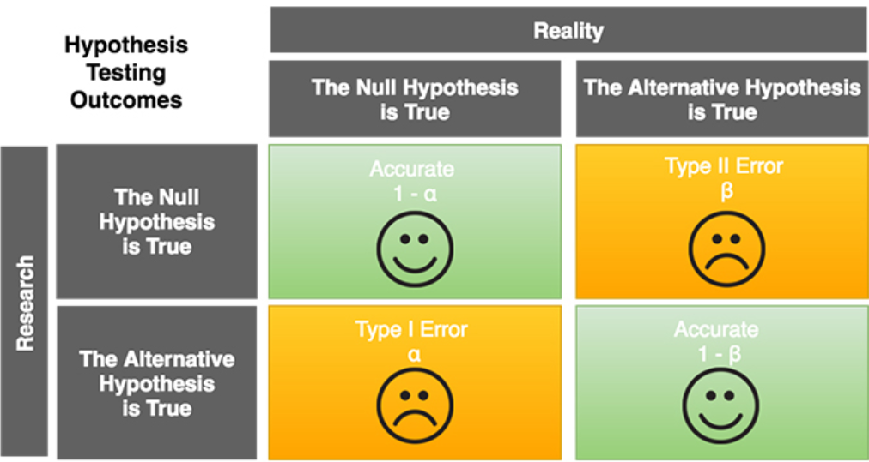



Hypothesis Testing
Null and Alternative Hypothesis
Two sided
One sided
Required Sample Size
Test
$$\text{≥}$$

Slide 22

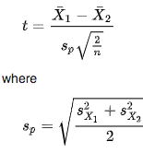
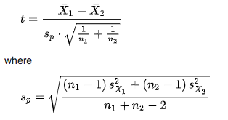
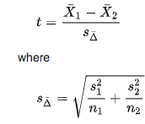
Testing
One Sample t-test
Null Hypothesis: Population mean is equal to a specified value
Two Sample t-test
Equal sample sizes and variances
Similar variances
Unequal variances
Null Hypothesis:
Both distributions have the same mean

Slide 23
Comparisons
Before
After
Two groups
Group C had Training while Group D had no Training. Did the training improve performance?

Slide 24
CHECL COMPARISOND USING R AND EXCEL

